Slide 1
Operating Systems
Chapter 3 (c)
Process Management
Hammad Afzal
hammad.afzal@mcs.edu.pk
Department of Computer Software Engineering
National University of Sciences and Technology

Slide 2
Roadmap
Inter-Process Communication
Examples of IPC Systems

Slide 3
Inter-process Communication
Processes within a system may be independent or cooperating
Cooperating process can affect or be affected by other processes.
Any process sharing data with other.
Reasons for cooperating processes:
Information sharing:
e.g. a share file
Computation speedup:
break process into sub tasks and each will execute in parallel with other (given multiple process units)
Modularity:
dividing the system into separate processes and threads

Slide 4
Inter-process Communication
Two models of IPC
Shared memory (SM):
A region of memory that is shared by cooperating processes is established.
Process then read and write data in shared region.
Message passing (MP)
Messages exchanged between two processes.
Many systems implement both mechanisms.
SM allows maximum speed; System calls required only to establish shared memory region.
MP useful for exchange small data; easier to implement for inter-computer communication. Slower than SM as they are implemented using system calls (kernel intervention).

Slide 5
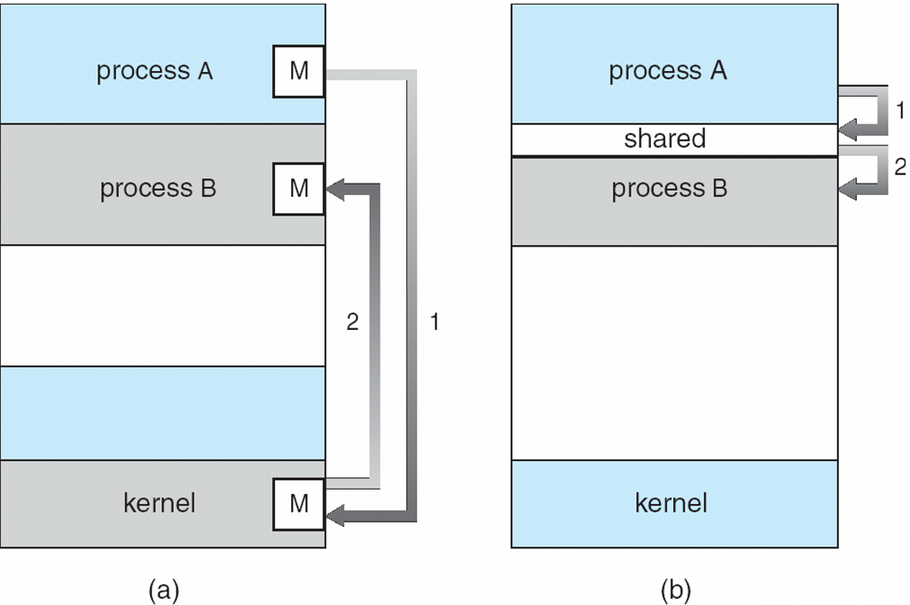
Communications Models

Slide 6
Shared Memory Systems
Shared Memory region resides in address space of creating process.
Other processes attach them to shared region.
OS restricts processes to read/write in other’s space.
SO Both process must agree to remove this restriction.
Processes ensure that they are not writing to same location simultaneously.

Slide 7
Producer-Consumer Problem
Paradigm for cooperating processes,
Producer process produces information that is consumed by a consumer process.
E.g. compiler produces assembly code that is used by assembler.
Shared Memory implementation:
A buffer in shared memory space available that can be filled by producer and emptied by consumer.
Producer and consumer must synchronize.

Slide 8
Producer-Consumer Problem
Two types of Buffers.
Unbounded-buffer places no practical limit on the size of the buffer.
Bounded-buffer assumes that there is a fixed buffer size
The code for accessing and sharing the memory region should be written by application programmer.

Slide 9
Bounded-Buffer – Shared-Memory Solution
Shared data
#define BUFFER_SIZE 10
typedef struct {
. . .
} item;
item buffer[BUFFER_SIZE];
int in = 0;
int out = 0;
Solution is correct, but can only use BUFFER_SIZE-1 elements

Slide 10
Bounded-Buffer – Producer
while (true)
{ /* Produce an item */
while (((in = (in + 1) % BUFFER SIZE count) == out)
; /* do nothing -- no free buffers */
buffer[in] = item;
in = (in + 1) % BUFFER SIZE;
}

Slide 11
Bounded Buffer – Consumer
while (true) {
while (in == out)
; // do nothing -- nothing to consume
// remove an item from the buffer
item = buffer[out];
out = (out + 1) % BUFFER SIZE;
return item;
}

